Slide 1
Forensic investigation
Case study

Slide 2
Disclaimer!

Slide 3
Scott Tyree
Considered one of earliest digital forensics case (2002)
Scott kidnapped 13 yo on January 1st
Send a photo of bounded girl to another man via instant message

Slide 4
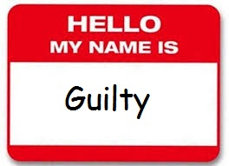
Scott Tyree
Another man saw girl in newspaper and contacted FBI on January 3rd
FBI contacted Yahoo and get IP of Scott
Notes:
masterforteenslavegirls

Slide 5
BTK ("Bind, Torture, Kill")
Serial killer
Killed 10 people (mostly by strangling to death) in years 1974-1991
Stopped activity for 13 years
Notes:
Otwarcie przyznawał się do morderstw. Pisał do gazet listy domagające się pseudonimu i sam wymyślił swój. Domagał się uwagi mediów.

Slide 6
BTK
Suddenly resume communication in 03.2004
One of industrial cameras recorded his car (black jeep)
In one of letters he asked police if floppy disk can be traced back

Slide 7
BTK
FBI used metadata from “removed” files to connect floppy disk to “Dennis” from Christ Lutheran Church
Car was a match
DNA from crime scene was 50% match with his daughter DNA
Notes:
Metadata (jak na wykładzie o steanografi)
“Usuwanie plików”

Slide 8
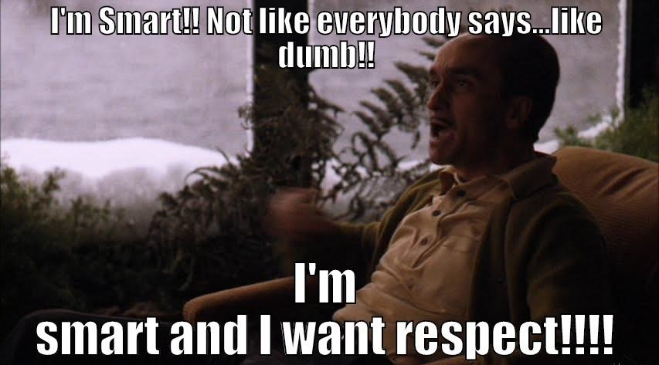
Wiped out
Bob switched work
His first company (Acme) suspected that he takes away some inside data of company to competitor
Bob fully cooperated

Slide 9
Wiped out
Bob (smart guy) used some wiping software to destroy data in unallocated space
Smart, isn’t it?
Notes:
F**k you, F**k you, F** you, F**k …
Lepsze patterny też nie działają zbyt często
Zazwyczaj zostają w systemie operacyjnym różne artefakty, które pozwalają wykryć takie rzeczy

Slide 10
RDP bounce
Big company realises they have a breach on at least one computer
Company was using Windows on thousands of computers
Windows event log showed that computer was accessed by RDP and RDP was used inside this session
Notes:
Remote Desktop Protocol

Slide 11
RDP Bounce
RDP chain turned out to be very long
Finally the target was found and stolen data was identified
Attacker was identified in few minutes
How?

Slide 12
Printer
Notes:
Przekierowywanie drukarki
Jedno małe okienko, które zniweczyło godziny roboty
Make your research

Slide 13
Nickelback
Company suspected that guy took confidential company’s data to the competitor (standard case)
Data was on computer, but everything looks fine, but...
He has really, reaaaaaaally extended versions of the Nickelback songs (700MB mp3 song)
Notes:
1min to zależnie od parametrów konwersji od 1MB to 10MB zazwyczaj koło 2-3

Slide 14
Nickelback
Sadly for the suspect such a thing as file signature analysis script exist
Turned out that all the Nickelback mp3s were full length .avi pornography videos
Videos was used by the suspect during the work time
Notes:
file signature analysis porównuje format pliku z oczekiwaną strukturą wewnętrzną i wskazuje najbardziej podejrzane pliki

Slide 15
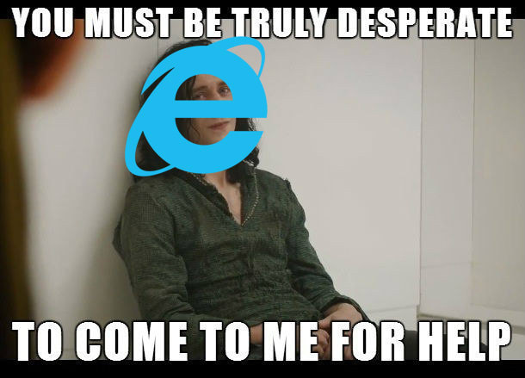
The Cloud aka IE Treason
Standard case with strong suspicion
Focus on list of customers
Most of standard methods (Link files, BagMRU, Jump list) show no evidence, but...
Notes:
Gość, który miał dostęp do listy klientów zmienił firmę dla konkurencji i kilku z klientów się z nimi dogadało.

Slide 16
The Cloud aka IE Treason
IE history was not wiped and opening of .html was found
html contained javascript which transferred a lot of confidential files to filesanywhere.com (dropbox for corporate use)
It looks serious, right?

Slide 17
The Cloud aka IE Treason - extra
Lawyer of opposite during “discovery phase” hand to investigators .pst files of client...
...and this file was rather boring
...at first glance.
Notes:
PST - Personal Storage Table (.pst) is an open proprietary file format used to store copies of messages, calendar events, and other items

Slide 18
The Cloud aka IE Treason - extra
From .pst you can pretty easily recover old files
Turn out that lawyer of thief told him to delete all the mails before handing them to prosecutor
Nice way to lose licence
Notes:
Jeżeli poprostu otworzy się taki plik w edytorze hex i wyzeruje bajty 7-12 to wtedy Outlook repair tool odsłania wszystkie wykasowane maila

Slide 19
Thanks for attention
Piotr Banaś

Slide 20
Sources
https://en.wikipedia.org/wiki/Dennis_Rader
https://forensicswiki.org/wiki/Famous_Cases_Involving_Digital_Forensics
https://www.youtube.com/watch?v=NG9Cg_vBKOg
https://en.wikipedia.org/wiki/Personal_Storage_Table

