Slide 1
Network security protocols
The Internet isn’t insecure. It may be unsecure.
Insecurity is mental state. The users of
the Internet may be insecure, and perhaps
rightfully so……Simson Garfinkel

Slide 2
Protocol is a set of rules that governs the communications between computers on a network.
Network security protocols are a type network protocol that ensures the security and integrity of data in transit over a network connection. Network security protocols define the processes and methodology to secure network data from any illegitimate attempt to review or extract the contents of data.
Network security protocols generally implement cryptography and encryption techniques to secure the data so that it can only be decrypted with a special algorithm, logical key, mathematical formula and/or a combination of all of them.

Slide 3
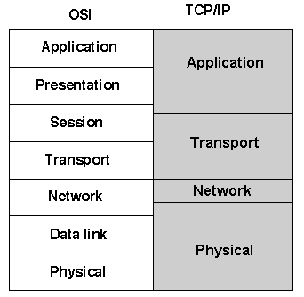
The call for and desire for security and privacy has led to the advent of several proposals for security protocols and standards.
We will consider these protocols in both the ISO and TCP/IP stacks.

Slide 4
TCP/IP | ISO | Security protocols
Application | Application Presentation | RADIUS, TACACS, PGP, S/MIME, S-HTTP, HTTPS, SET, SSH, and Kerberos
Transport | Session Transport | SSL and TLS
Network | Network | PPTP, L2TP, IPsec, and VPNs
Physical | Data link Physical | packet filters, NAT, CHAP, and PAP

Slide 5
TCP/IP | ISO | Security protocols
Application | Application Presentation | RADIUS, TACACS, PGP, S/MIME, S-HTTP, HTTPS, SET, SSH, and Kerberos
Transport | Session Transport | SSL and TLS
Network | Network | PPTP, L2TP, IPsec, and VPNs
Physical | Data link Physical | packet filters, NAT, CHAP, and PAP

Slide 6
Pretty Good Privacy (PGP)
developed by Phil Zimmermann in 1991,
reason was to protect sensitive information. PGP is used for signing, encrypting, and decrypting texts, e-mails, files, directories, and whole disk partitions and to increase the security of e-mail communications,
based on asymmetric cryptography that uses a pair keys to operate – a public key and a private key,
ensures confidentiality and verification of communication.
Application layer protocols

Slide 7
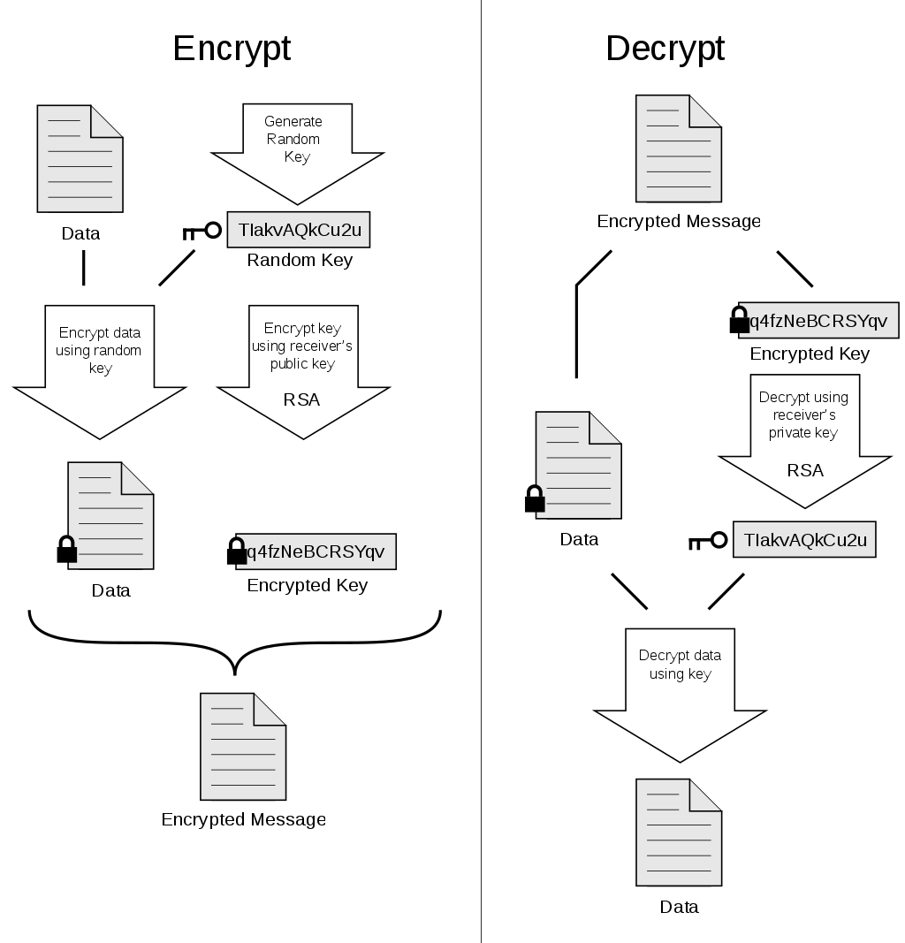
How PGP encryption works
PGP provides confidentiality by encrypting messages before transmission. For each message to be sent, the sender mints a brand new 128-bit session key for the message. The session key is encrypted with RSA or Diffie-Hallman using the recipient’s public key; the message is encrypted using CAST-128 or IDEA or 3DES together with the session key. The combo is transmitted to the recipient. Upon receipt, the receiver uses RSA with his or her private key to encrypt and recover the session key which is used to recover the message.
Application layer protocols

Slide 8
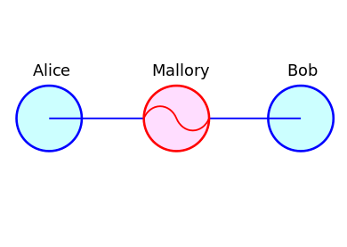
Man-in-the-middle attack
Message can be captured and changed
Someone can publish his public key and claim that he is different person
Need system to verify message and public keys.
Application layer protocols

Slide 9
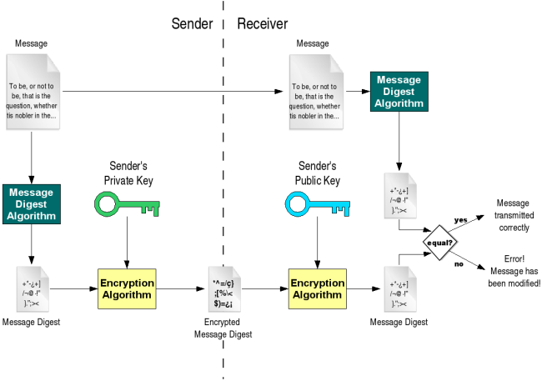
How PGP verification works
Message can be captured and changed. To protect against this, message has to be signed.
Sender compute hash of the message, encrypt it with his private key and add to message as signature.
Receiver decrypt signature using sender’s public key and decrypt message using his private key. Next step is to compute hash of the message and compare it with signature.
If the document is subsequently modified in any way, a verification of the signature will fail.
Application layer protocols

Slide 10
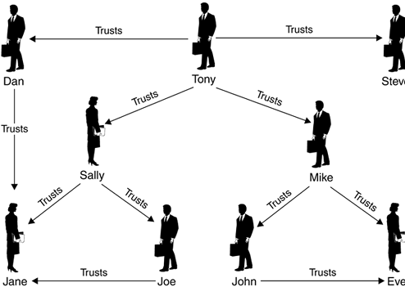
How PGP works
Public Key Cryptography infrastructure (PKI)
Is given key belongs really to the person stated in the key?
PGP solves this problem, by creating a circle of trust among its users. Each user has an own keyring with public keys, and create certificate for each key in which specify how much he trust that this key is valid. PGP rely on trust relationships between regular users.
Application layer protocols

Slide 11
How PGP works
Best practices
Do not blindly trust keys from public servers
Have a strong private key
2048 and 4096 bit long RSA numbers are considered as reasonable for long term secure systems
Use an expiration date
Replying to an encrypted email, sent items and drafts

Slide 12
Secure/Multipurpose Internet Mail Extension (S/MIME)
transfer of multimedia data including pictures, audio, and video,
extends the protocols of Multipurpose Internet Mail Extensions (MIME) by adding digital signatures and encryption to them,
based on asymmetric cryptography that uses a pair keys to operate – a public key and a private key,
Application layer protocols

Slide 13
How S/MIME works
Encryption and signing process is similar to PGP. It is based on asymmetric cryptography and digital signature.
The biggest difference is in Public Key Cryptography infrastructure (PKI). PKI has two implementations:
One rely on trust relationships between regular users as it is implemented in PGP.
Second one is done using certificates and certificate authorities (CAs). And it is implemented in S/MIME.
Application layer protocols

Slide 14
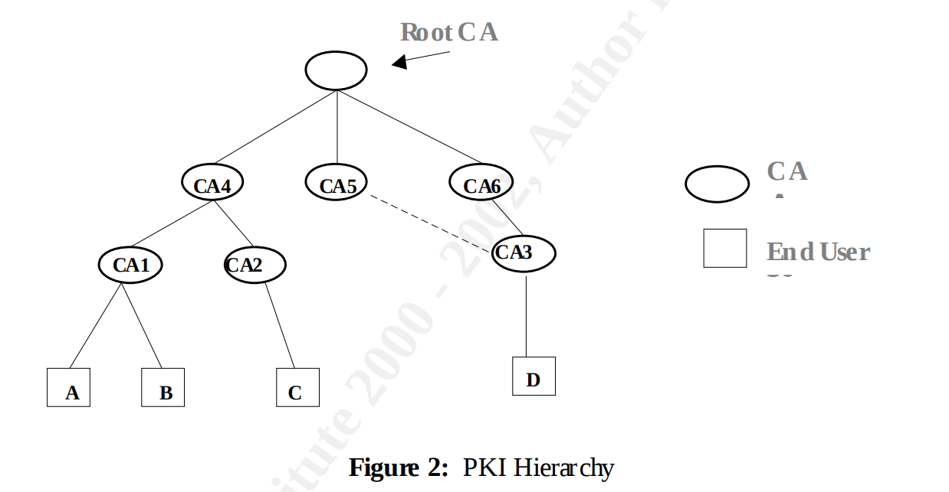
How S/MIME works
Public Key Cryptography infrastructure (PKI)
S/MIME certificates is digital ID, which has to be create by certificate authority (CA),
certificate has public, private key and unique id of the owner of certificate,
it forms centralized web of trust,
S/MIME is mostly used inside of corporations. It is best suited for structured organizational hierarchies with an implicitly trusted authority that vouches for all issued certificates (every company can create its own CA)
Application layer protocols

Slide 15
CA certificates
There are 3 types of CA certificates:
Free Self-signed certificate
Free Let's Encrypt SSL certificates
Paid Professionally-signed certificate ($15/year)
Most of the largest international CAs offer three levels of assurance for their SSL/TLS Certificates.
Extended Validation (EV) SSL – checks right of the applicant to use domain and strict organizational vetting.
Organization Validated (OV) SSL – checks right of the applicant to use domain and some organizational vetting.
Domain Validated (DV) SSL – checks right of the applicant to use domain.

Slide 16
Secure HTTP (S-HTTP)
created in 1994 by Enterprise Integration Technologies (EIT)
extends the Hypertext Transfer Protocol by adding message encryption, digital signature, and message and sender authentication.
the system is not tied to any particular cryptographic system, key infrastructure, or cryptographic format.
uses a symmetric key cryptosystem in the negotiations that prearranges symmetric session keys and a challenge-response mechanism between communicating parties.

Slide 17
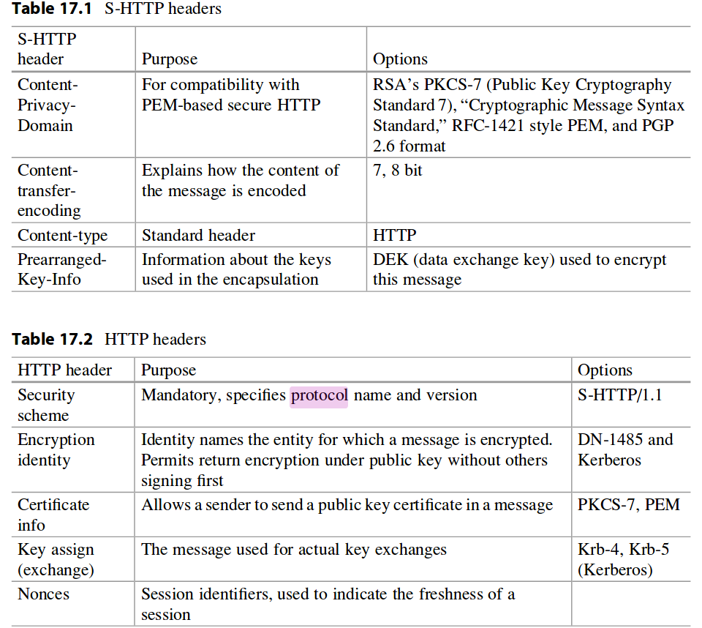

Slide 18
Cryptographic Algorithm for S-HTTP
Normally process would go as follows (K - client, S - server) :
K -> S
Request for a page. Along with this request, the browser lists encryption schemes it supports and also includes its public key.
S -> K
Responds to the client browser by sending a list of encryption schemes it also supports. The server may, in addition, send the browser session key encrypted by the client’s browser’s public key.
If the client’s browser does not get a session key from the server:
K -> S
Sends message which contain a session key or a value the server can use to generate a session key for the communication. A message is encrypt with the server’s public key.

Slide 19
Cryptographic Algorithm for S-HTTP
Sending requested page
Upon the receipt of the page/message from the server, the client’s browser, if possible, matches the decryption schemes in the S-HTTP headers (recall this was part of the negotiations before the transfer), which include session keys, and then decrypts the message
Closing communication
In HTTP transactions, once the page has been delivered to the client’s browser, the server would disconnect. However, with S-HTTP, the connection remains until the client browser requests the server to do so. This is helpful because the client’s browser encrypts each transmission with this session key.

Slide 20
Digital signatures for S-HTTP
S-HTTP allows both certificates from a certificate authority (CA) and a self-signed certificate (usually not verified by a third party). If the server requires a digital certificate from the client’s browser, the browser must attach a certificate then.

Slide 21
Message and Sender Authentication in S-HTTP
S-HTTP uses an authentication scheme that produces a MAC. The MAC is actually a digital signature computed from a hash function on the document using a shared secret code.
MAC = Hash function [secret key, primary data, padding, sequence number],

Slide 22
Hypertext Transfer Protocol over Secure Socket Layer (HTTPS)
Web protocol developed by Netscape, and it is built into its browser to encrypt and decrypt user page requests as well as the pages that are returned by the Web server.
HTTPS is the use of Secure Sockets Layer (SSL) as a sub-layer under the regular HTTP in the application layer.
SSL encrypt messages and send it over HTTPS protocol.

Slide 23
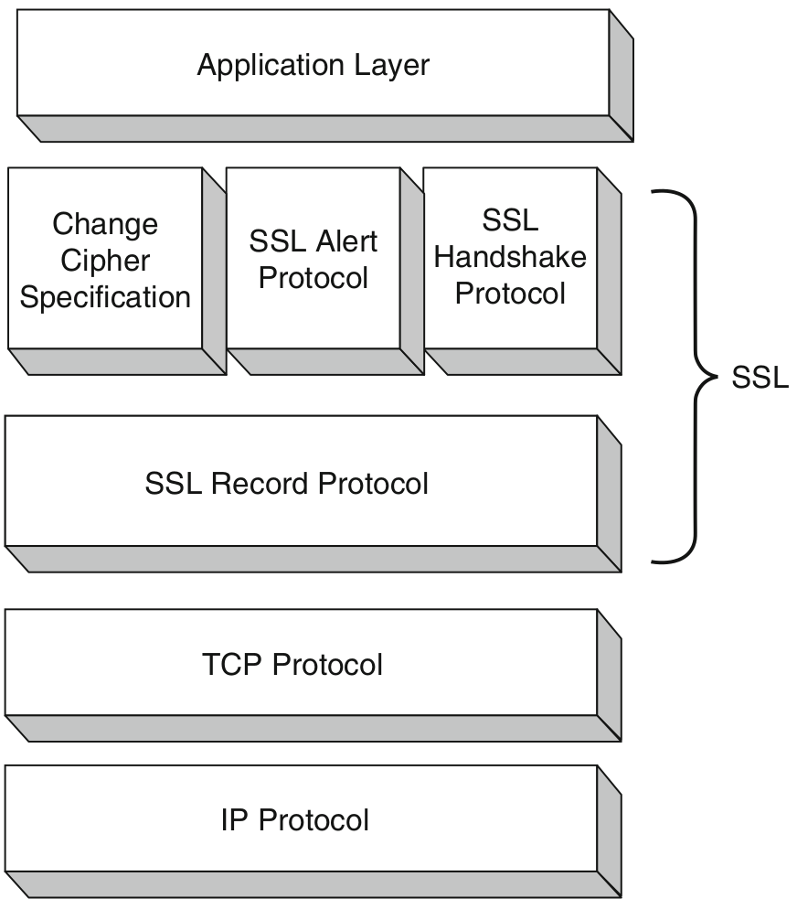
Secure socket layer (SSL)
Data encryption
Created in 1994
Ensures : Data encryption, server and client authentication, message integrity
Consist of 2 layers and 4 protocols.

Slide 24
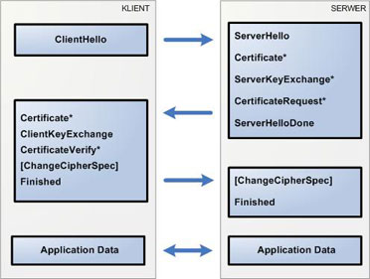
Secure socket layer (SSL)
Ths SSL Handshake protocol
Task:
Establish a cipher suite to use between them
Provide mandatory server authentication through the server sending its certificate to the client to verify that the server’s certificate was signed by a trusted CA.
Provide optional client authentication, if required, through the client sending its own certificate to the server to verify that the client’s certificate was signed by a trusted CA.
Exchange key information using public key cryptography,

Slide 25
SSL Record Protocol
Data to be send: fragments, compresses it, adds a MAC, encrypts it together with the MAC, adds an SSL header, and transmits it under the TCP protocol.
Received data: decrypted, verified, and decompressed before it is forwarded to higher layers.
The MAC, computed from a hash algorithm such as MD5 or SHA-1 as
MAC = Hash function [secret key, primary data, padding, sequence number], is used to verify the integrity of the message included in the transmitted record.

Slide 26
SSL vs S-HTTP
In 1994 both SSL and S-HTTP protocols was launched.
Both systems were designed for Web-based commerce.
Both allow for the exchange of multiple messages between two processes
Both use similar cryptographic schemes such as digital envelopes, signed certificates, and message digest
Where are the differences? Why SSL is more common?
DESIGN: S-HTTP was designed to work with only Web protocols. SSL can work in many other network protocols ( Because SSL is at a lower level in the network stack than S-HTTP )
IMPLEMENTATION: SSL is again at a lower level than S-HTTP, it is implemented as a replacement for the sockets API to be used by applications requiring secure communications.
DISTRIBUTION: SSL was released in a free mass circulating browser, the Netscape Navigator. S-HTTP was released in a much smaller and restricted NCSA Mosaic.
This unfortunate choice doomed the fortunes of S-HTTP

Slide 27
Transport Layer Security (TLS)
Created in 1999 .
successor to SSL 3.0
attempt at standardization of a secure method to communicate over the Web
referred as SSL/TLS
Additional features have been added:
Interoperability—ability to exchange TLS parameters by either party, with no need for one party to know the other’s TLS implementation details
Expandability—to plan for future expansions and accommodation of new protocols

Slide 28
Secure Shell (SSH)
Implemented in application layer in TCP/IP and in session layer in ISO.
public/private asymmetrical key pairs that can be created are only used for authentication
symmetric keys are used to encrypt the entire connection
provides strong authentication and secure encrypted data communications between two computers connecting over an insecure network such as the Internet.
used by network administrators for managing systems and applications remotely, allowing them to log in to another computer over a network, execute commands and move files from one computer to another.

Slide 29
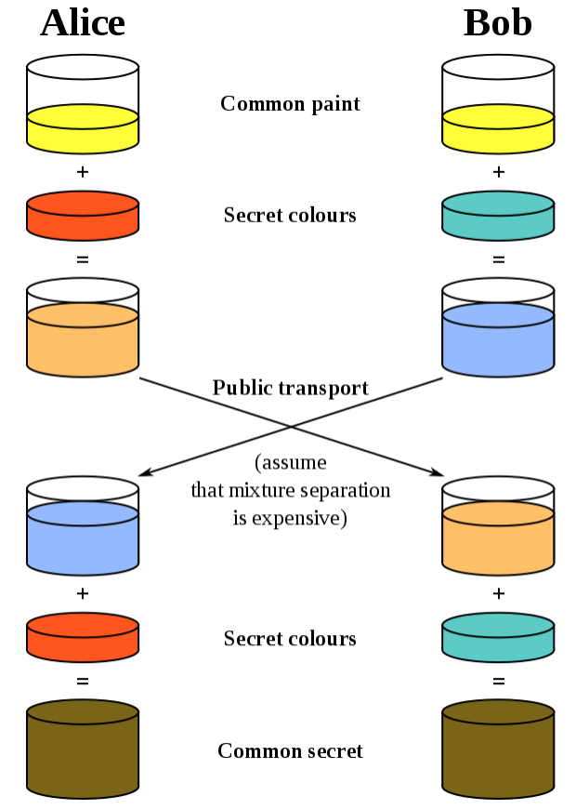
Secure Shell (SSH)
Negotiating Encryption for the Session
Both parties agree on a large prime number, which will serve as a seed value.
Both parties agree on an encryption generator (typically AES), which will be used to manipulate the values in a predefined way.
Independently, each party comes up with another prime number which is kept secret from the other party. This number is used as the private key for this interaction (different than the private SSH key used for authentication).
The generated private key, the encryption generator, and the shared prime number are used to generate a public key that is derived from the private key, but which can be shared with the other party.
Both participants then exchange their generated public keys.
The receiving entity uses their own private key, the other party's public key, and the original shared prime number to compute a shared secret key. Although this is independently computed by each party, using opposite private and public keys, it will result in the same shared secret key.
The shared secret is then used to encrypt all communication that follows.

Slide 30
Secure Shell
Authenticating the User's Access to the Server
Password authentication
Server simply prompts the client for the password of the account they are attempting to login with. The password is sent through the negotiated encryption, so it is secure from outside parties. (NOT RECOMMENDED)

Slide 31
Secure Shell
Authenticating the User's Access to the Server, Asymmetric authentication
K- client, S - Server
K -> S : sends an ID for the key pair it would like to authenticate with to the server.
S: check's the authorized_keys file of the account that the client is attempting to log into for the key ID. If a public key with matching ID is found in the file, the server generates a random number and uses the public key to encrypt the number.
S -> K: sends this encrypted message.
K: decrypt the message using private key, revealing the original number. Then client combines the decrypted number with the shared session key that is being used to encrypt the communication, and calculates the MD5 hash of this value.
K -> S: sends this MD5 hash back to the server as an answer to the encrypted number message.
S: The server uses the same shared session key and the original number that it sent to the client to calculate the MD5 value on its own. It compares its own calculation to the one that the client sent back. If these two values match, it proves that the client was in possession of the private key and the client is authenticated.

Slide 32
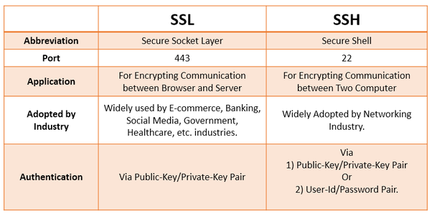

Slide 33
Internet Protocol Security (IPsec)
designed to the inherent lack of security for IP-based networks,
authenticates and encrypts the packets of data sent over a network,
can protect data flows between a pair of hosts (host-to-host), between a pair of security gateways (network-to-network), or between a security gateway and a host (network-to-host)
runs transparently to transport layer and application layer protocols which do not see it.
Ensures:
network-level peer authentication,
data-origin authentication, data integrity,
data confidentiality (encryption),
replay protection.
There are two main modes of IPSec operation :
Transport Mode
Tunnel Mode

Slide 34
Internet Protocol Security (IPsec)
Tunnel Mode
Must be used when you require an ipsec gateway to gateway connection
IPsec encrypts the entire ip packet along with its headers and then generates a new header to stick on top of the encrypted ip packet.
Then it computes hash of message + IP header and attach as new AH header.
IPSec creates a brand new header and attaches it in front of the completely encrypted ip packet.

Slide 35
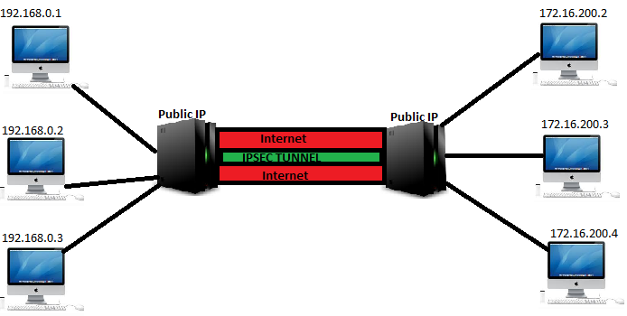
Internet Protocol Security (IPsec)
Tunnel Mode, example

Slide 36
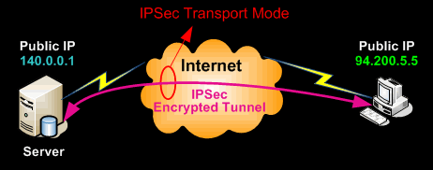
Internet Protocol Security (IPsec)
Transport Mode
Transport mode is very much similar to the tunnel mode with two major differences.
It does not change the original IP header
Also it does not create a new IP header
Used in host-to-host communication

Slide 37
Internet Protocol Security (IPsec)
How it works
Protocol consists of two major components:
Authentication Header (AH) protocol - is used for authentication, and also for data integrity protection, and provides protection against replay attacks. Works on a technology called as keyed hash algorithm for MAC. A simple hash algorithm creates a Message authentication hash, only based upon the data.
Encapsulation Security Payload (ESP) protocol - initial versions of ESP provided only the encryption part, and authentication as well as integrity protection was entirely provided by AH header.
But later advancements in ESP made it capable of doing both the authentication, integrity checks, as well as encryption.
ESP uses a symmetric key encryption where the same key is used for both the encryption as well as decryption. ESP divides data to smaller chunks and encrypts it with AES(Advanced Encryption Standard) algorithm.

Slide 38
Internet Protocol Security (IPsec)
Example
192.168.0.2 wants to communicate with 172.16.200.3
Step 1: 192.168.0.2 creates a packet with the destination address of 172.16.200.3. This packet is not an ipsec packet
Step 2: The network packet reaches the gateway of 192.168.0.0/24
Step 3: The gateway of 192.168.0.0/24 will do a Network Address Translation and will change the source IP address to its own public IP address
Step 4: On looking at the packet, the gateway at the 192.168.0.0/24 comes to know that this packets need to be protected by encryption and integrity protection.
Step 5: Gateway at 192.168.0.0/24 network will start to negotiate encryption and MAC algorithms and other secret keys with the target gateway. This negotiation is done by either the aggressive or the main mode.
Step 6: Now the packet is encrypted and a new ip header is attached as its the tunnel mode, and is send to the gateway at 172.16.200.0/24 network.
Step 7: On recieving this packet the gateway at 172.16.200.0/24 network will look at the headers to determine the association, and will remove the additional header and decrypt the remaining header and payload.
Step 8: Finally the unencrypted packet is send to the destination of 172.16.200.3 by the gateway at 172.16.200.0/24 network.

Slide 39
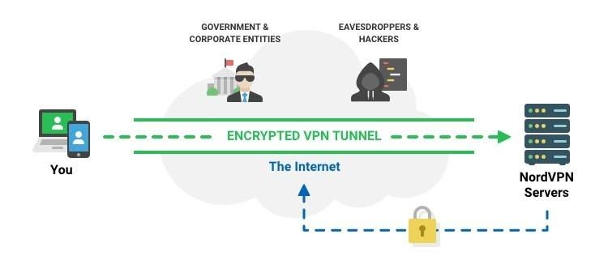
Virtual private network (VPN)
secure tunnel between two or more devices and enables users to send and receive data across shared or public networks as if their computing devices were directly connected to the private network.
hide your IP address and location
encrypt your communications
makes internet free, open and private

Slide 40
Virtual private network (VPN)
connect your computer or another device, such as a smartphone or tablet) to a VPN,
computer acts as if it’s on the same local network as the VPN,
network traffic is sent over a secure connection to the VPN,
VPN forwards the request for you and forwards the response from the website back through the secure connection

Slide 41
Virtual private network (VPN)
Example of use
Access a Business Network While Traveling
Hide Your Browsing Activity From Your Local Network and ISP
Access Geo-Blocked Websites
Downloading Files

Slide 42
Virtual private network (VPN)
Secure VPN protocols include the following:
Internet Protocol Security (IPsec)
Transport Layer Security (SSL/TLS)
Datagram Transport Layer Security (DTLS)
Microsoft Point-to-Point Encryption (MPPE)
Microsoft Secure Socket Tunneling Protocol (SSTP)
Secure Shell (SSH) VPN –

Slide 43
Bibliografia
Joseph Migga Kizza, “Guide to Computer Network Security”, Springer International Publishing AG 2017. https://link.springer.com/book/10.1007/978-3-319-55606-2
Eyas Al-Hajery, “Trust Model in PGP and X.509 Standard PKI” https://www.giac.org/paper/gsec/625/trust-model-pgp-x509-standard-pki/101441

Slide 44
Internet Protocol Security (IPsec)
Internet Key Exchange Protocol (IKE), Main mode
Uses 3 pairs of packets
Initiator sending a proposals to the responder. The proposals define what encryption and authentication protocols are acceptable, how long keys should remain active, and whether perfect forward secrecy should be enforced, for example. The first exchange between nodes establishes the basic security policy;
The responder chooses the appropriate proposal (we'll assume a proposal is chosen) and sends it to the initiator.
The next exchange passes Diffie-Hellman public keys and other data. All further negotiation is encrypted within the IKE SA. The third exchange authenticates the ISAKMP session. Once the IKE SA is established, IPSec negotiation (Quick Mode) begins.

Slide 45
Internet Protocol Security (IPsec)
Internet Key Exchange Protocol (IKE), Aggressive mode
Aggressive Mode squeezes the IKE SA negotiation into three packets.
It establishes the same thing with only three messages instead of the three pair used in Main mode.

