Slide 1
TPM, TEE, SGX Technologies

Slide 2
Trusted Platform Module

Slide 3
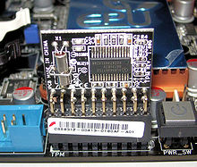
TPM(Trusted Platform Module) technology is designed to provide hardware-based, security-related functions. A TPM chip is a secure crypto-processor that is designed to carry out cryptographic operations.
The most common TPM functions are used for system integrity measurements and for key creation and use.

Slide 4
The TPM specification by the Trusted Computing Group’s (TPG’s) was aimed at addressing the following major issues in the industry:
Identification of devices: Prior to the release of the TPM specification, devices were mostly identified by MAC addresses or IP addresses—not security identifiers.
Secure generation of keys: Having a hardware random-number generator is a big advantage when creating keys. A number of security solutions have been broken due to poor key generation.
Secure storage of keys: Keeping good keys secure, particularly from software attacks, is a big advantage that the TPM design brings to a device.
NVRAM(Non Volatile Random Access Memory) storage: When an IT organization acquires a new device, it often wipes the hard disk and rewrites the disk with the organization’s standard load. Having NVRAM allows a TPM to maintain a certificate store.
Device health attestation: Prior to systems having TPMs, IT organizations used software to attest to system health. But if a system was compromised, it might report it was healthy, even when it wasn’t.

Slide 5
Rootkit attack
A rootkit is a special type of malware (malicious software). Rootkits are special because you don't know what they're doing. Rootkits are nearly undetectable and they're almost impossible to remove. Although detection tools are proliferating, malware developers are constantly finding new ways to cover their tracks.
A rootkit's purpose is to hide itself and other software from view. This is done to prevent a user from identifying and potentially removing an attacker's software. A rootkit can hide almost any software, including file servers, keyloggers, botnets, and remailers. Many rootkits can even hide large collections of files and thus enable an attacker to store many files on your computer invisibly.

Slide 6
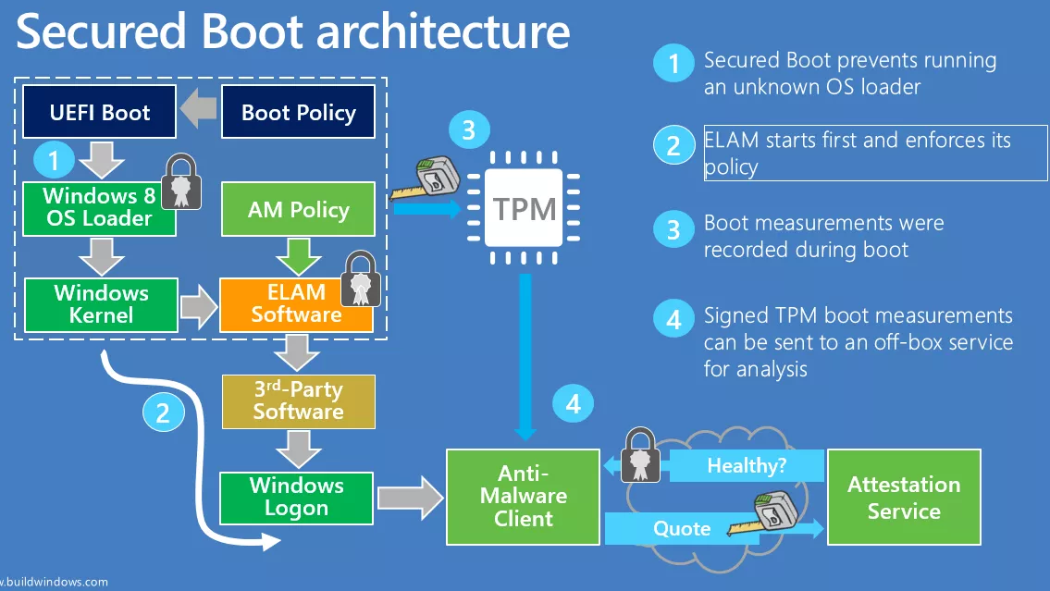

Slide 7
Disk encryption with BitLocker and TPM
BitLocker - is a full disk encryption feature included with Windows Vista and later.
Encryption Modes:
TPM only(vulnerable to a cold boot attack)
TPM + PIN
TPM + USB

Slide 8
TPM chip was hacked by Christopher Tarnovsky in 2010, but in ’near impossible’ way. Tarnovsky needed six months to figure out his attack, which requires skill in modifying the tiny parts of the chip without destroying it. He required lab equipment represents an investment of about $200,000.
In 2015, as part of the Snowden revelations, it was revealed that in 2010 a US CIA team claimed at an internal conference to have carried out a differential power analysis attack against TPMs that was able to extract secrets.

Slide 9
Anonymity with TPM.

Slide 10
Trusted Execution Environment

Slide 11
Trusted Execution Environment (TEE) device security technology offers a secure operating system that is isolated from the device OS (e.g. Android), making it, and trusted applications residing in it, highly protected from software threats and hacking.
Trusted Execution Environment: a safe place for cryptographic operations, storing sensitive data (keys, private data, etc.), and executing sensitive operations all running alongside the main operating system. This functionality is invisible to the end users but to application developers it is an ideal area for security critical operations.

Slide 12
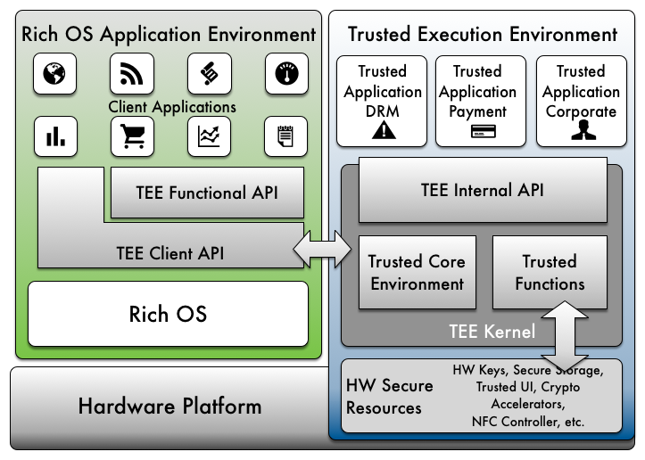

Slide 13
Trusted User Interface
The Trusted User Interface feature allows a Trusted Application to interact directly with the user via a common display and touch screen. It protects the confidentiality and integrity of the information exchanged between a Trusted Application and the user from the Rich OS by use of hardware isolation built in to most modern smartphones.

Slide 14
Secure Input: The information entered by the user to a Trusted Application cannot be derived or modified by any software within the Rich OS or by another unauthorized Trusted Application.
Secure Display: The information displayed by the Trusted Application cannot be accessed, modified, or obscured by any software within the Rich OS or by another unauthorized Trusted Application.

Slide 15
BOOMERANG: a class of vulnerabilities that arises due to this semantic separation between the TEE and the untrusted environment. These vulnerabilities permit untrusted user-level applications to read and write any memory location in the untrusted environment, including security-sensitive kernel memory, by leveraging the TEE’s privileged position to perform the operations on its behalf. BOOMERANG can be used to steal sensitive data from other applications, bypass security checks, or even gain full control of the untrusted OS. 2017 year.

Slide 19
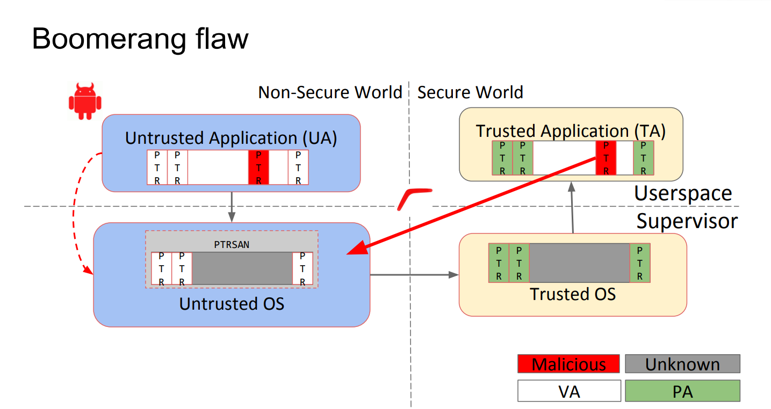

Slide 20
Intel SGX(Software Guard Extensions)

Slide 21
This Intel technology is for application developers who are seeking to protect select code and data from disclosure or modification. Intel® SGX makes such protections possible through the use of enclaves, which are protected areas of execution in memory. Application code can be put into an enclave by special instructions and software made available to developers via the Intel SGX SDK. The SDK is a collection of APIs, libraries, documentation, sample source code, and tools that allows software developers to create and debug applications enabled for Intel SGX in C and C++.

Slide 22
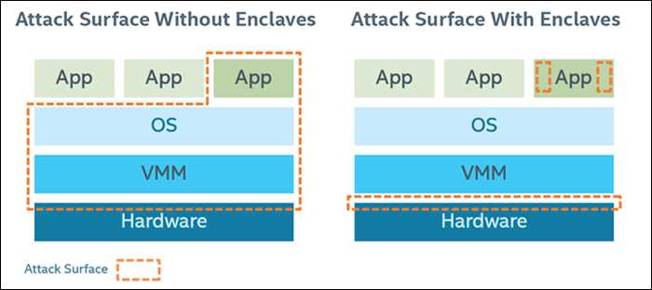

Slide 23
Intel SGX offers the following protections from known hardware and software attacks:
Enclave memory cannot be read or written from outside the enclave regardless of the current privilege level and CPU mode.
Production enclaves cannot be debugged by software or hardware debuggers. (An enclave can be created with a debug attribute that allows a special debugger—the Intel SGX debugger—to view its content like a standard debugger. This is intended to aid the software development cycle.)
The enclave environment cannot be entered through classic function calls, jumps, register manipulation, or stack manipulation. The only way to call an enclave function is through a new instruction that performs several protection checks.
Enclave memory is encrypted using industry-standard encryption algorithms with replay protection. Tapping the memory or connecting the DRAM modules to another system will yield only encrypted data.
The memory encryption key randomly changes every power cycle (for example, at boot time, and when resuming from sleep and hibernation states). The key is stored within the CPU and is not accessible.
Data isolated within enclaves can only be accessed by code that shares the enclave.

Slide 24
Application design with Intel SGX requires that the application be divided into two components (see Figure 3):
Trusted component. This is the enclave. The code that resides in the trusted code is the code that accesses an application’s secrets. An application can have more than one trusted component/enclave.
Untrusted component. This is the rest of the application and any of its modules. It is important to note that, from the standpoint of an enclave, the OS and the VMM are considered untrusted components.

Slide 25
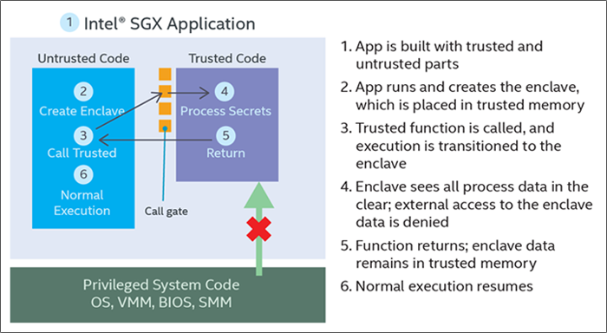

Slide 26
In the Intel SGX architecture, attestation refers to the process of demonstrating that a specific enclave was established on a platform. There are two attestation mechanisms:
Local attestation occurs when two enclaves on the same platform authenticate to each other.
Remote attestation occurs when an enclave gains the trust of a remote provider.

Slide 27
Local Attestation
Local attestation is useful when applications have more than one enclave that need to work together to accomplish a task or when two separate applications must communicate data between enclaves. Each enclave must verify the other in order to confirm that they are both trustworthy. Once that is done, they establish a protected session and use an ECDH Key Exchange to share a session key. That session key can be used to encrypt the data that must be shared between the two enclaves.
Because one enclave cannot access another enclave’s protected memory space, even when running under the same application, all pointers must be dereferenced to their values and copied, and the complete data set must be marshaled from one enclave to the other.

Slide 28
Remote Attestation
With remote attestation, a combination of Intel SGX software and platform hardware is used to generate a quote that is sent to a third-party server to establish trust. The software includes the application’s enclave, and the Quoting Enclave (QE) and Provisioning Enclave (PvE), both of which are provided by Intel. The attestation hardware is the Intel SGX-enabled CPU. A digest of the software information is combined with a platform-unique asymmetric key from the hardware to generate the quote, which is sent to a remote server over an authenticated channel. If the remote server determines that the enclave was properly instantiated and is running on a genuine Intel SGX-capable processor, it can now trust the enclave and choose to provision secrets to it over the authenticated channel.

Slide 29
https://rd.springer.com/chapter/10.1007/978-1-4302-6584-9_3

