Slide 1
MSA Security Introduction

Slide 2
Microservices Architecture
Upsides and downsides
Characteristics and patterns
Security
Vulnerabilities

Slide 3
Microservices
“The term "Microservice Architecture" has sprung up over the last few years to describe a particular way of designing software applications as suites of independently deployable services. […] there are certain common characteristics around organization around business capability, automated deployment, intelligence in the endpoints, and decentralized control of languages and data.” – Martin Fowler

Slide 4
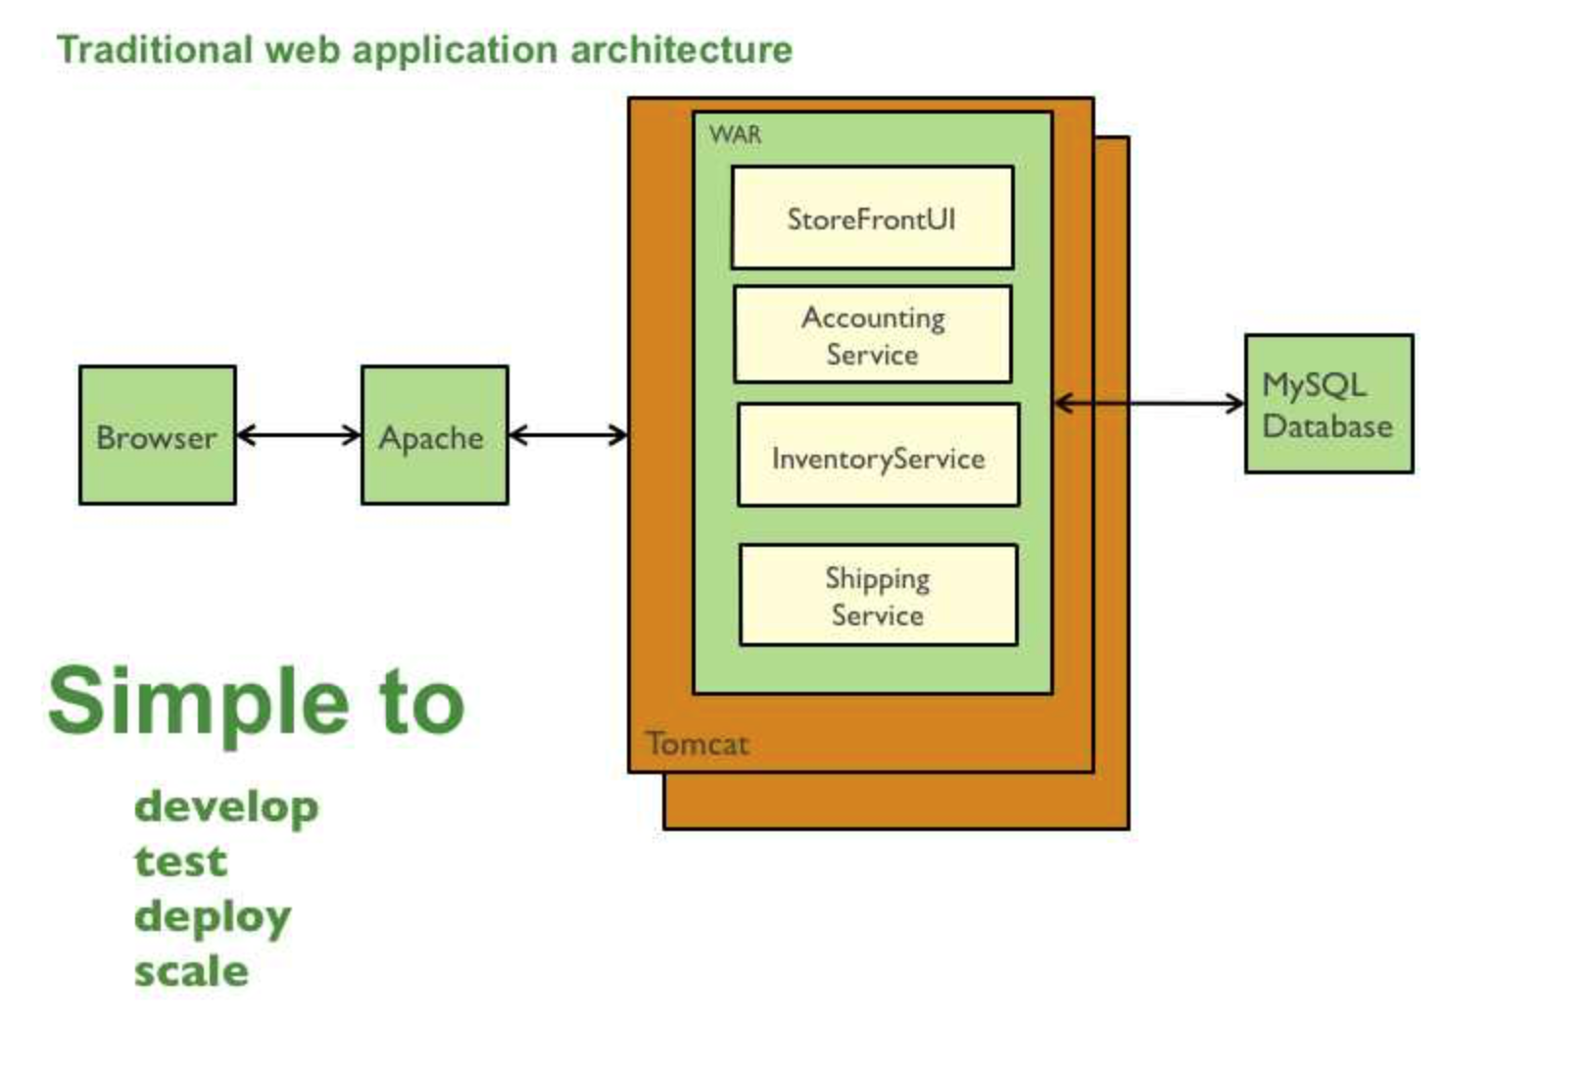
Monolithic application
Development: current development tools support monolithic approach
Deployment: deploy single .war into runtime
Scale: Run multiple instances of application behind load balancer
Notes:
plusy monolitów, powiedz coś fajnego

Slide 5
Monolithic application
Development: Large monolith intimidates new developers
Deployment: Practically no continuous deployment
Scalability: scaling for peak not for load.
Notes:
minusy monolitów, druga strona medalu

Slide 6
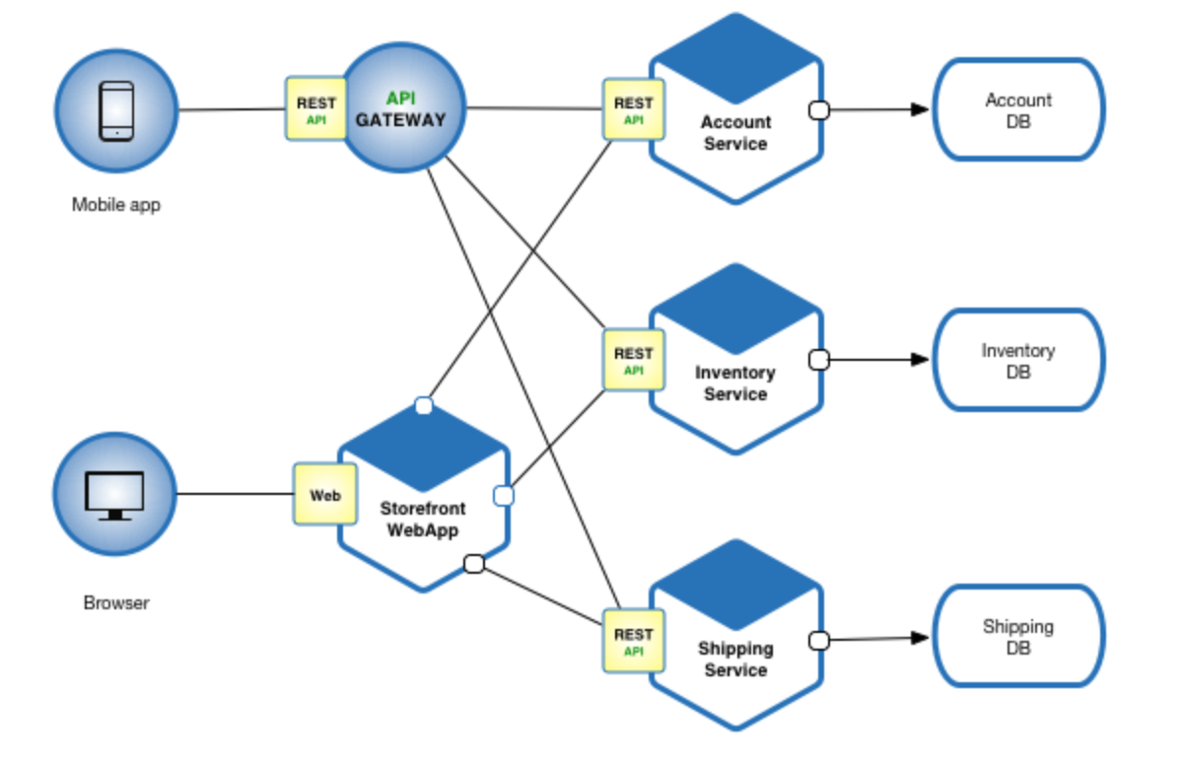
Microservices application
Each microservice is relatively small which boosts development.
Each service can be deployed independently(containers) – easier to deploy changes more frequently
Easier scaling – no need to deploy more instances of whole application
Notes:
shiny microservices

Slide 7
Microservices application
Need to develop inter-service communication. Implementing multi service use cases is difficult and requires coordination
Additional operational cost - managing system divided into smaller services
Notes:
not so shiny lol

Slide 8
Characteristics
Componentization via Services Component is a unit of software that is independently replaceable and upgradeable. Ideally changes only affect one small service – independently deployable.
Organized around Business Capabilities Splitting application into services organized around business context. Explicit separation required by service components makes it easier to keep the team boundaries clear.
Smart endpoints and dumb pipes Decouple all logics from communication layer and “be smart” instead – while building decoupled and cohesive, we gain lightweight message bus.
Decentralized governance Each service can be build using different technology and not affect the whole application. There is only matter of internal communication. We can choose the best tool for the job. Many languages = many options
Decentralized data management Each service has it’s own model of the world. Each service has(usually) own database. No single entity has responsibility for whole data.
Design for failure Application needs to be able to handle services failure and respond gracefully to client. It is important to be able to react to such events and restore service
Notes:
mocno dzielimy na komponenty, dzielimy komponenty per zespół i wszystko robimy osobno.

Slide 9
How big is a microservice?
Amazon’s Two Pizza Team Rule
Whole team can be fed by two pizzas.
Notes:
Ciekawostka

Slide 10
Patterns
Notes:
Dostatecznie dużo tych patternów. Omówmy kilka fajnych

Slide 11
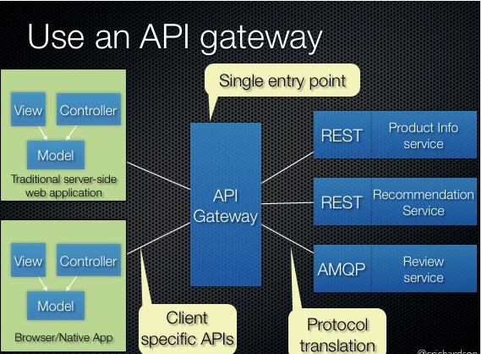
API Gateway
How does application communicate with dozens of individual services?
Single entry point for all clients
Consistent, easier to secure(e.g. access token)
Expose different APIs to different clients
Provide each client with the best suited API
Hide internal details from the client
Notes:
API gateway to dobry pomysł – recepta na wszystko, zwłaszcze security

Slide 12
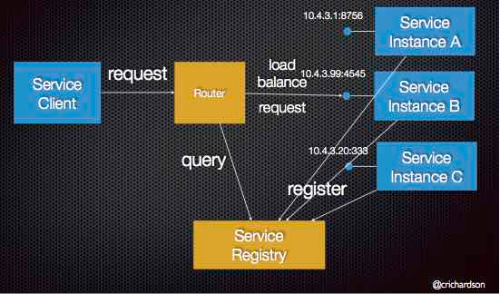
Service Discovery
How does client discover location of a service?
Virtual machines and containers usually get dynamic IPs
Dynamic number of services and instances
Client can simply query Router instance for location of available service
Notes:
Service discovery jest potrzebne, bo bawimy się w luźne wiązanie komponentów

Slide 13
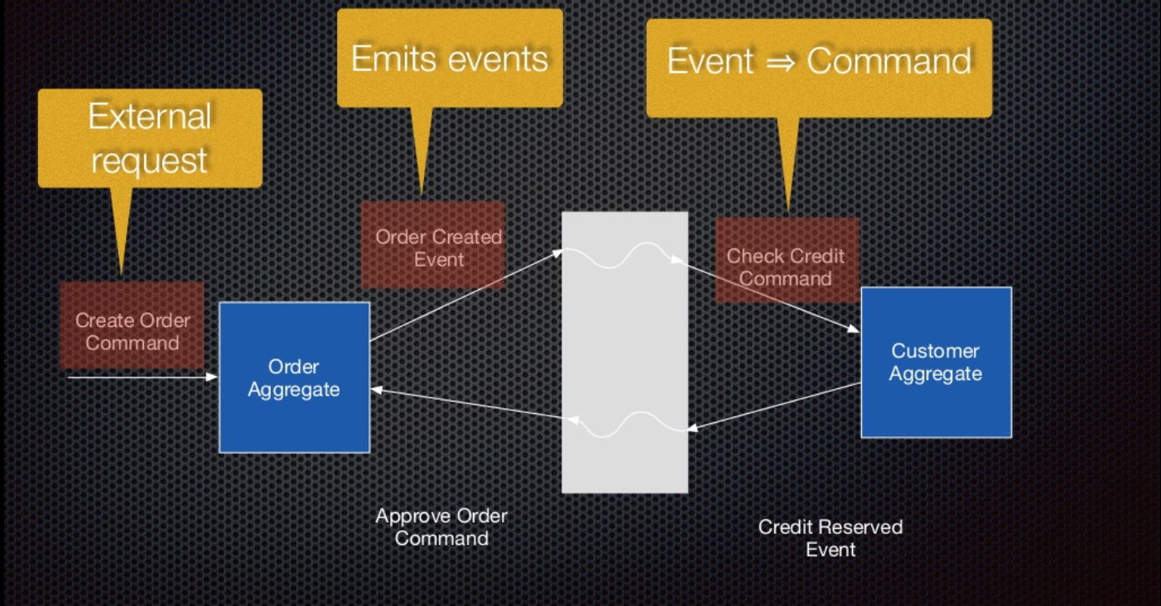
Event driven
How to deal with inconsistency across databases?
2PC is a bad practice
Identify events for each aggregate
E.g. Orders: Created, Cancelled, Approved, Rejected, Shipped
Notes:
Eventy wow. Bardzo interesująca architektura

Slide 14
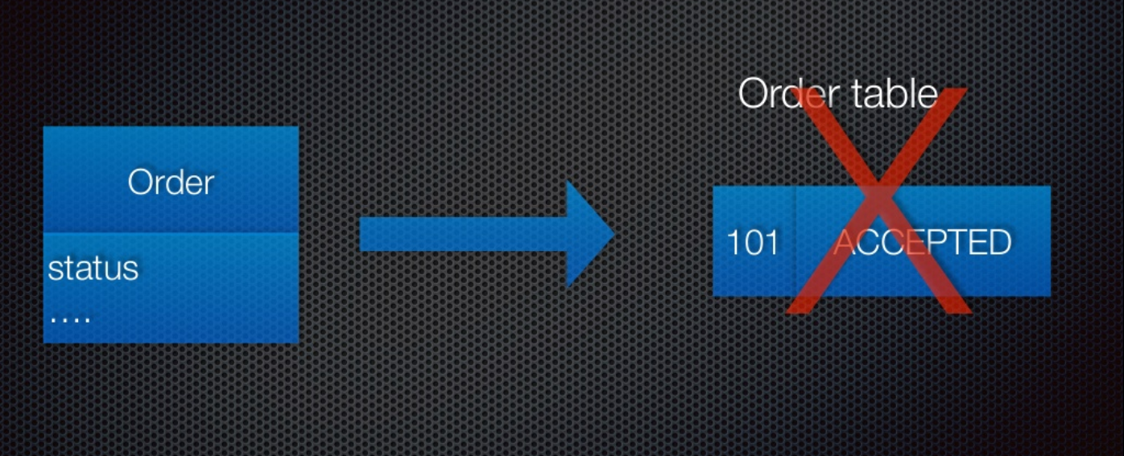
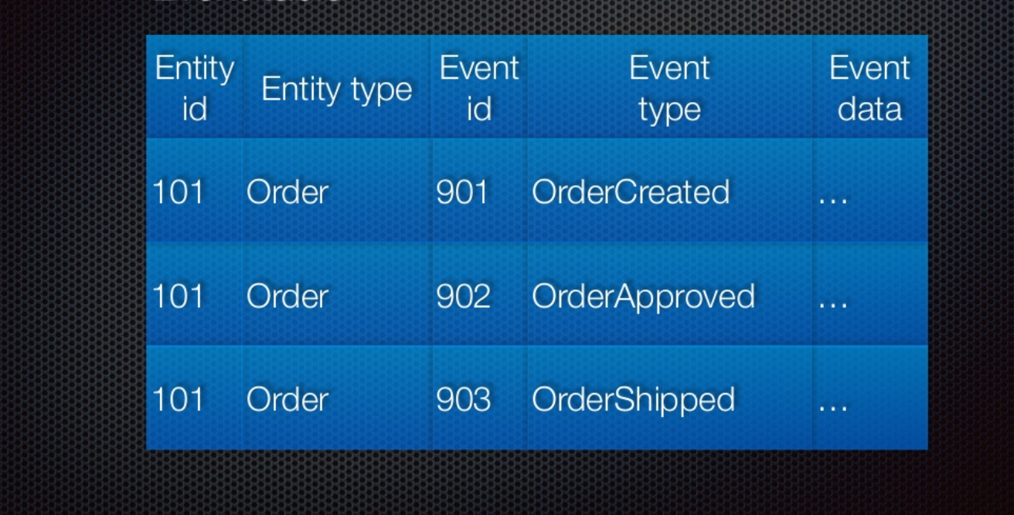
Persist events not state
Replay events to recreate state(periodical snapshot)
“Present is a fold over history”
Services publish and subscribes to events they are interested in
Solves data consistency issue
Preserves history(historical processing)

Slide 15
Security in MSA
Due to the architectural pattern microservices overall security is better in microservices
On the other side they introduce new vectors of attacks
Speed vs secure factor
Notes:
Zaczynamy z poważnym security. Omów ogóły

Slide 16
Upsides and downsides
Increased isolation - decoupling services adds boundaries between services in a system
One breach might not expose your whole application/data/stack
API can be well designed with rate limiting and throttling
New attack vectors and surfaces
Internal traffic goes through network or Internet instead of internal calls
Traditional app security still matters - data injection, cross-site scripting, etc
Notes:
+ I - | można powiedzieć coś fajnego

Slide 17
More possibilities
Granularity: You can apply service-specific rules everywhere
Diversity: You can apply different rules to different services and components
Distributed responsibility: Each microservice can specify how and by who it should be used(easier to enforce)
Tailored access: “Least privilege” model on service-service basis

Slide 18
Databases
Database per service – more db’s to secure
Do you use the same credentials everywhere?
How do you protect this credentials?
Do you restrict application’s movement across database?
Notes:
Z perspektywy baz danych to samo co zawsze było

Slide 19
Messaging layer
Does every system see every message?
Can your system send message anywhere?
Do you validate message body?

Slide 20
Edge/Web
Do you check what you expose to the web? No accidental admin url/panels leaks. No access to internal API. Validate and sanitize requests.
What data are you storing on the client side? Do you cache data? Is it protected?
Do you secure all your APIs? API Gateway with token, role based security

Slide 21
People
Are your team aware of security challenges? One unaware developer can destroy whole application
Do you have some security ground rules or practices? Everyone should be able to perform them.
Does the management know why you need this? This is not wasted money with no result.

Slide 22
Containers
Do you use trusted images? If you assemble built images be sure to check them.
Do you manage your secrets? Environment variables aren’t the best idea. Don’t put secrets inside containers and don’t expose them to host. Secret should live as long as container leaves and disappear.
You are replacing hundreds of VMs with thousand of containers. Are you able to audit and control them?
Notes:
Container secrets: priviledged, access of control etc

Slide 23
Good practices
Encrypt traffic wherever you can
Use identity and access control
Never rely only on edge security(defense in depth)
API Gateway – get your services out of public network
Monitoring and audits – you must know what happens inside all the time

Slide 24
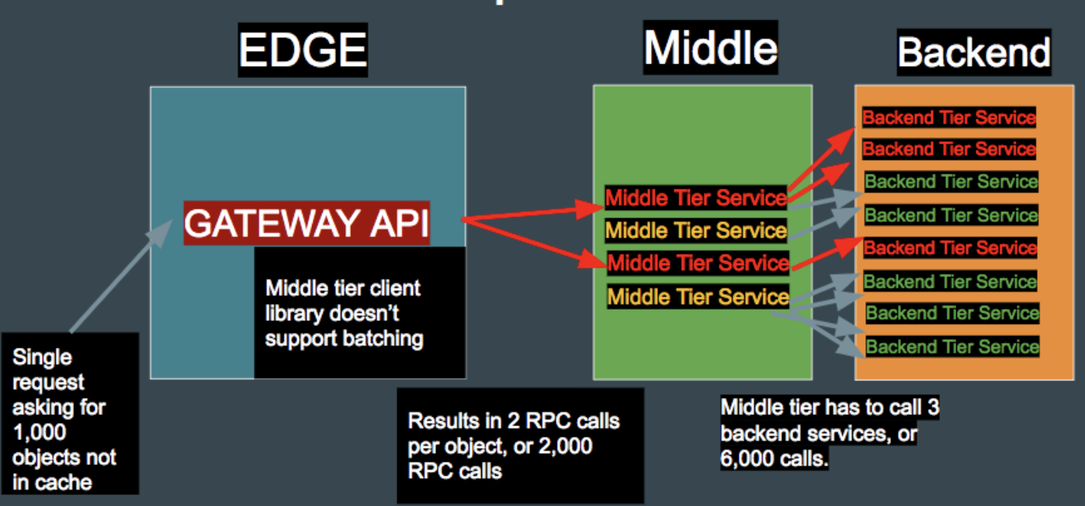
Application Layer DDoS
Raising popularity
In microservices world they can be really effective
Can flood every tier service
by

Slide 25
Summary
Must deal with increased complexity, but with more possibilities of securing application
Easier to lose control over microservices than monoliths if you don’t step in fast enough
It’s imperative for everyone(from development to management) to have awareness about risks and security

Slide 26
Literature
www.martinfowler.com
www.microservices.io
“Security in A Microservice World” - Jack Mannino (https://www.owasp.org/images/2/20/Microservice_Security.pdf)
“Mastering Chaos – A Netflix guide to Microservices” (https://www.youtube.com/watch?v=CZ3wIuvmHeM)
“10 Tips for failing badly at Microservices” – David Shmitz (https://www.youtube.com/watch?v=X0tjziAQfNQ)
“Microservices Security: All The Questions You Should Be Asking” (http://www.grahamlea.com/2015/07/microservices-security-questions/)
“Tips for Securing a Modernized Service-Based Architecture” (https://www.upwork.com/hiring/development/microservices-security/)
Nice to watch: https://www.youtube.com/watch?v=gfh-VCTwMw8

